Slide 1
A Geometric Clustering Tool (AGCT) with music data
Using AGCT to cluster short sequences of music

Slide 2
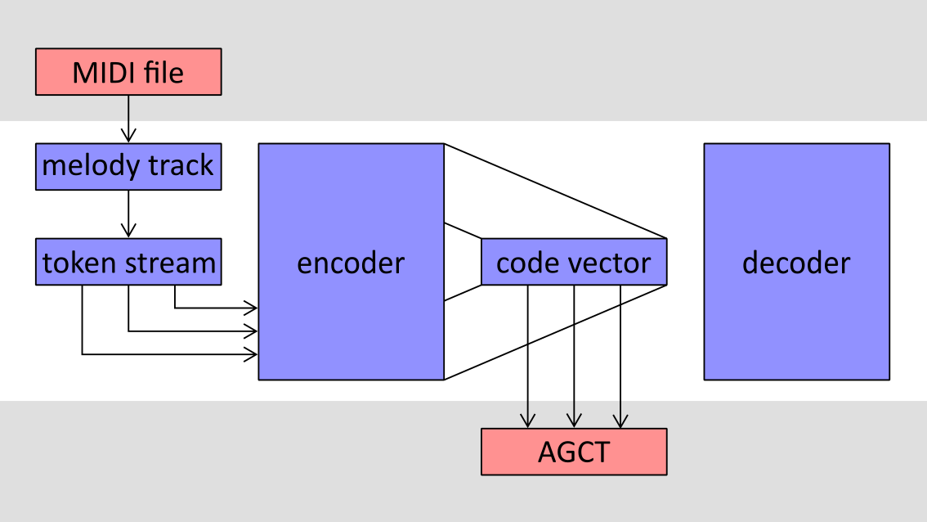
Schematic overview

Slide 3
Melody track
Problem statement not so clear:
Definition of melody track?
Accuracy measure?
Existence?
Melody track assumed to be available somehow
Training dataset: Lakh Pianoroll Dataset (lpd-5-cleansed) [1]
was already (partially) classified

Slide 4
Tokenization
Convert a music track into a sequence of “commands” (tokens).
Two types:
Time shift tokens advance the current time for a given number of fractions of a beat.
Note tokens start a note at current time with given pitch and length.
Similar to one in MuseNet [2]

Slide 5
Autoencoder
Build an autoencoder to learn a suitable representation
Modeled after “Sequence to Sequence Learning with Neural Networks” paper by Ilya Sutskever, Oriol Vinyals, and Quoc V Le.
Originally a model for natural language processing
Iteratively feed tokens into the encoder to accumulate a state vector (also called hidden vector)
Reconstruct the sequence from state vector
Feed state vector into AGCT

Slide 6
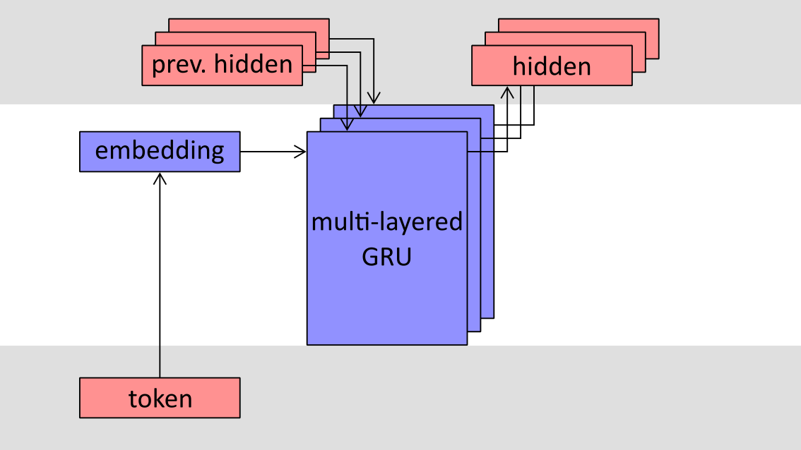
Encoder

Slide 7
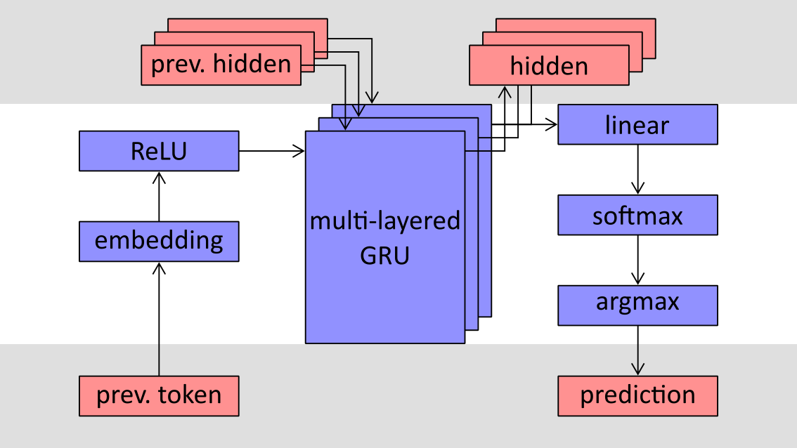
Decoder

Slide 8
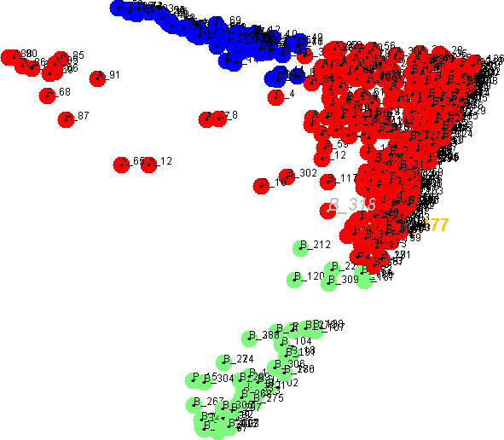

Examples
 | original | reconstruction
Song 1 (acc = 0.97)
Song 2 (acc = 0.78)

Slide 9
References
Ilya Sutskever, Oriol Vinyals, and Quoc V Le. Sequence to sequence learning with neural networks. In Advances in neural information processing systems, pages 3104–3112, 2014.
Cheng-Zhi Anna Huang, Ashish Vaswani, Jakob Uszkoreit, Ian Simon, Curtis Hawthorne, Noam Shazeer, Andrew M Dai, Matthew D Hoﬀman, Monica Dinculescu, and Douglas Eck. Music transformer: Generating music with long-term structure. 2018.
Hao-Wen Dong, Wen-Yi Hsiao, and Yi-Hsuan Yang. Pypianoroll: Open source python package for handling multitrack pianoroll. In Proc. Int. Soc. Music Information Retrieval Conf, 2018.

